Slide 1
Add a Note – Feature
User Testing | Jan 2021

Slide 2
Let’s begin with the total:
Total: 46

Slide 3
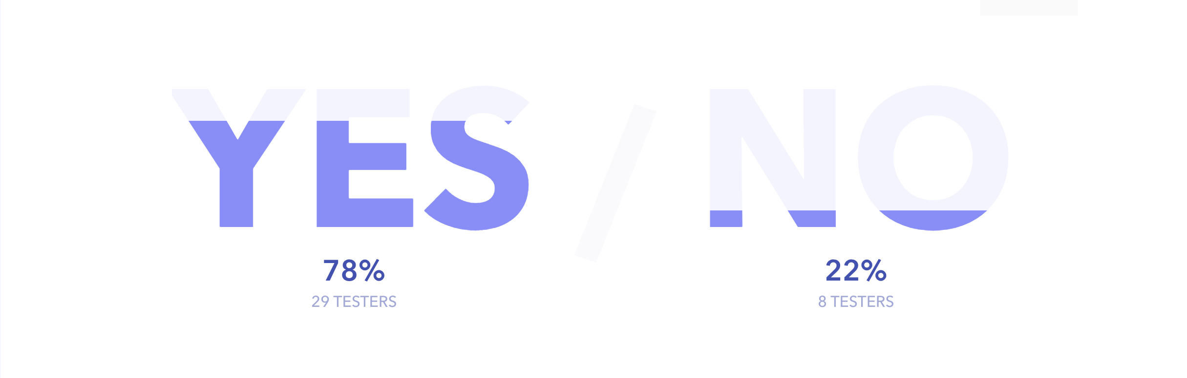
Would you use this feature?

Slide 4
We asked why not – See quotes
"I under this feature as being able to add comments to myself. I didn't understand from the UI that when another user will open the same report he/she will be able to see my notes. Also, I'm not sure if I want others to see my notes so maybe when adding notes I should be able to pick whether they are public or private.” Meir Tsvi
"It isn't very intuitive to use and I would rather use JIRA as the place I usually work on with other developers”
Asaf. K
"This adds too much functionality and UI logic to our product, and it is overloaded already.” Yael
"It largely depends on my (imagined) role... But the report's screens are packed with details already - not sure other users (or myself) would've noticed these notes in there.” Or P
Notes:
תוהים האם זה פומבי או פרטי
חושבים שעדיף ג׳ירה
עודף פונקציונאליות

Slide 5

#1
First Task
Create a note in the table
Tests the ability of the user to find the “Kabab Menu”
in the table and add a note using the menu

Slide 6
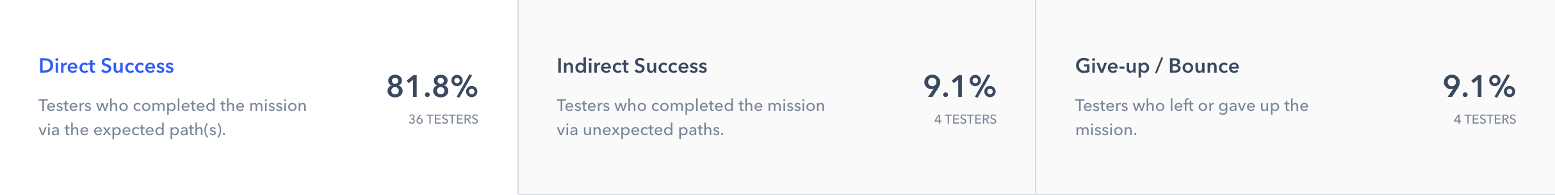
#1: Create a note in the table
Statistics

Slide 7
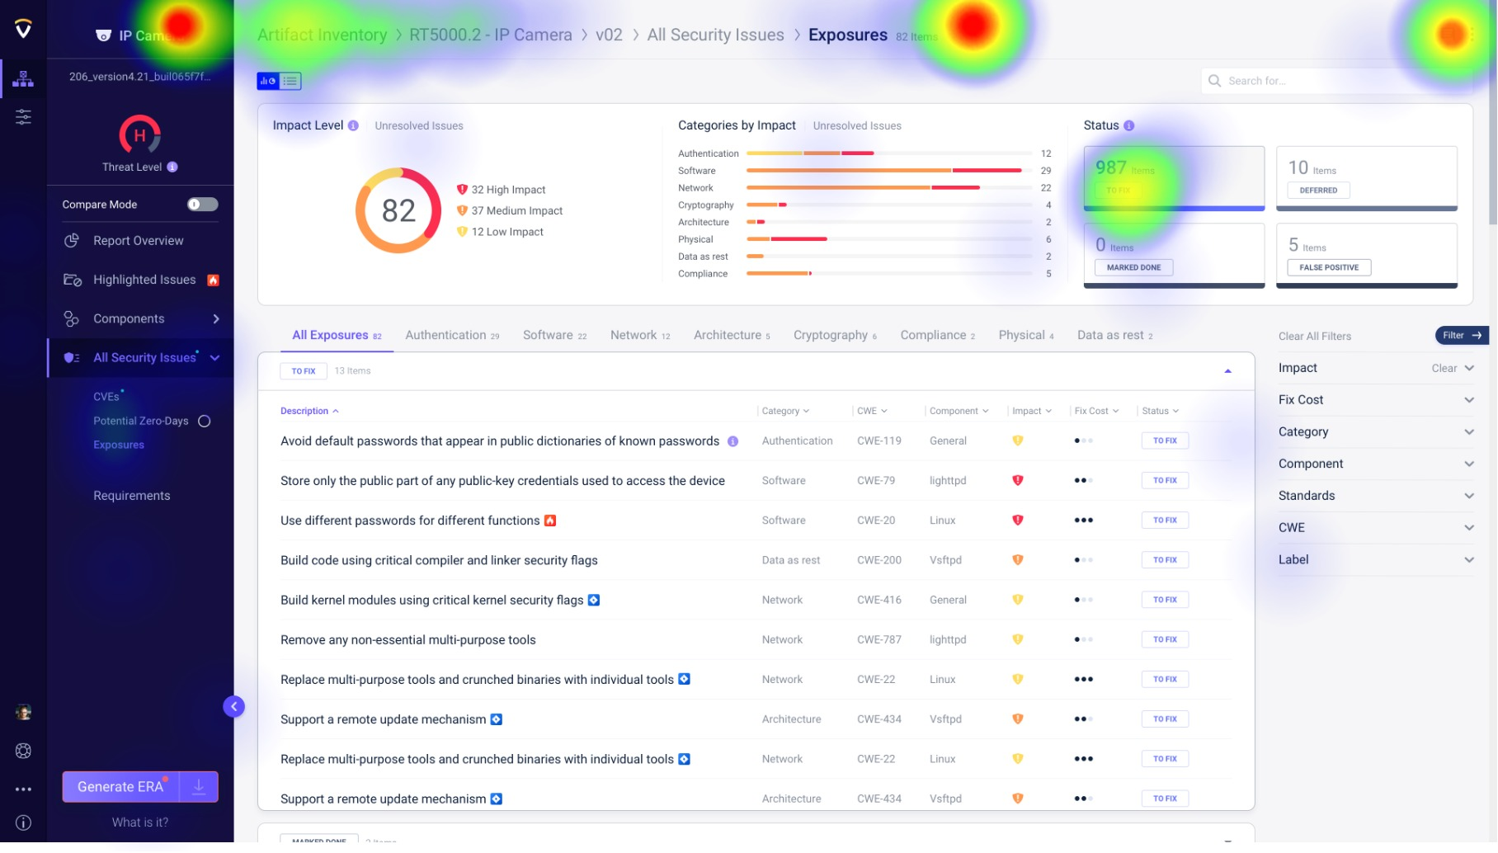
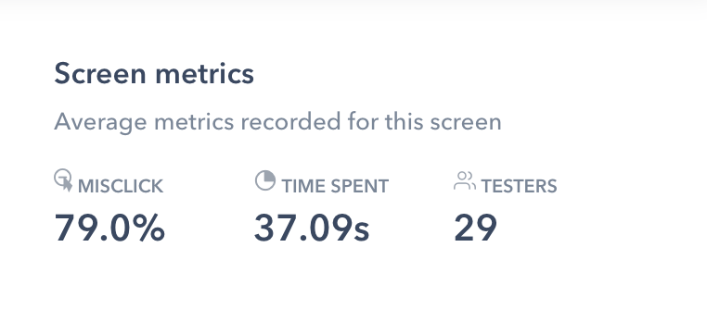

Slide 8
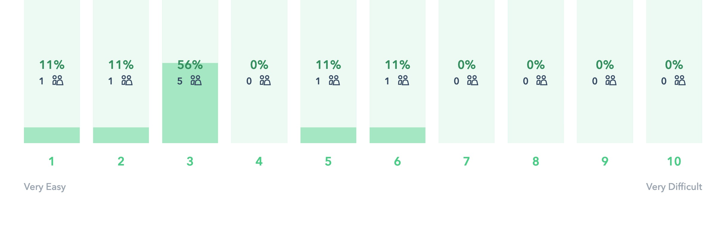
#1: Create a note in the table
Rank the difficulty level
Average: 3

Slide 9
We asked for suggestions – See quotes
”Not really i think like all SaaS software, you discover things as you go I guess
a new user will not know that he can add a note, but after a few sessions he will discover that there
is the possibility great testing option by the way ” Ofer
"Why not add the record options to on mouse->right-click on all the table record and Not just hidden in the 3 dots? ” Hagay Onn
”No comments, was pretty intuitive” Vladimir Torgovitsky
"I naturally tried 'right-clicking' (before seeing the "..." button) - maybe add this option as well” Or P
Notes:
קליק ימני
אולי לא הכי ברור איפה הפעולה

Slide 10
First Task - Add Note in table: Maybe at this point not use the kabab menu for adding a note or considering making the “Kabab menu” more visible or using an “Add note” icon instead of “kabab menu”.
Notes:
קליק ימני
אולי לא הכי ברור איפה הפעולה

Slide 11
#2
Second Task
Try to add a note to the report
Tests the ability of the user to find the “Add Note” icon
on the top of the report and open the “Add Note Window”
Notes:
למצוא את האייקון ולפתוח את החלונית

Slide 12
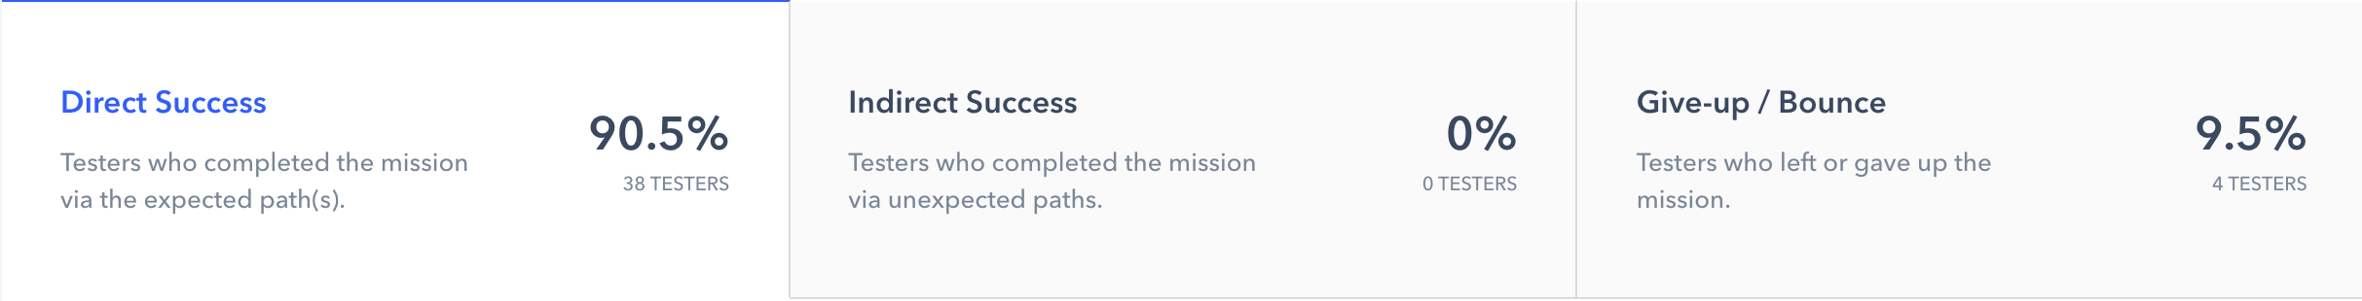
#2: Try to add a note to the report
Statistics
Notes:
היה קל יחסית כי לא הוצאו הרבה מסלולים

Slide 13
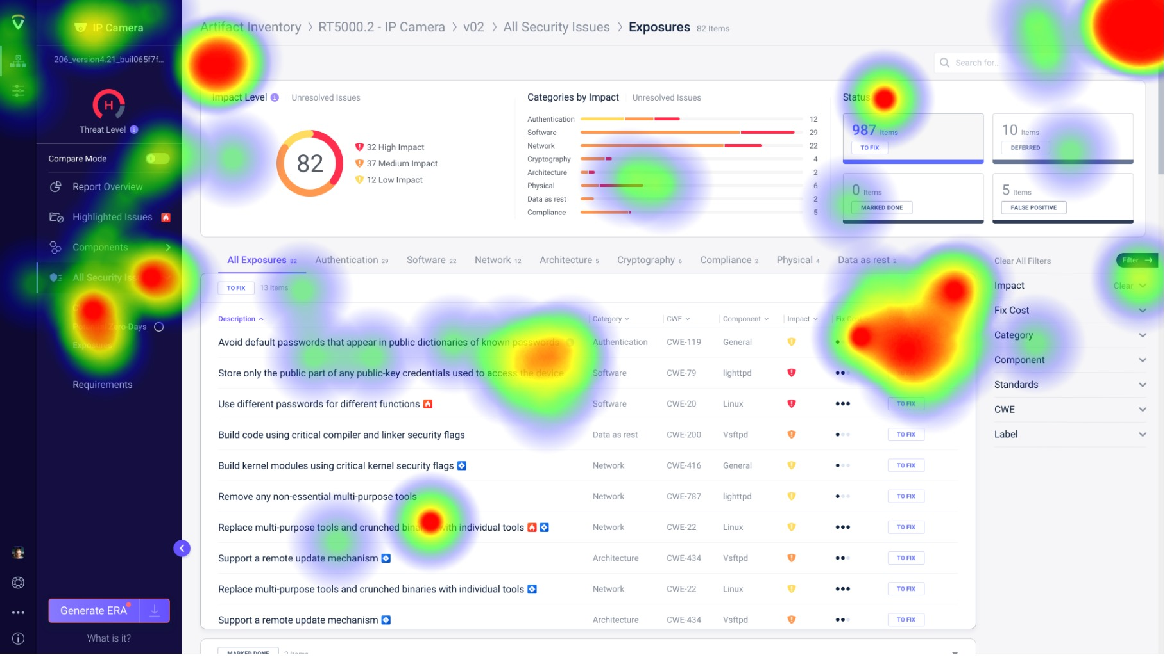
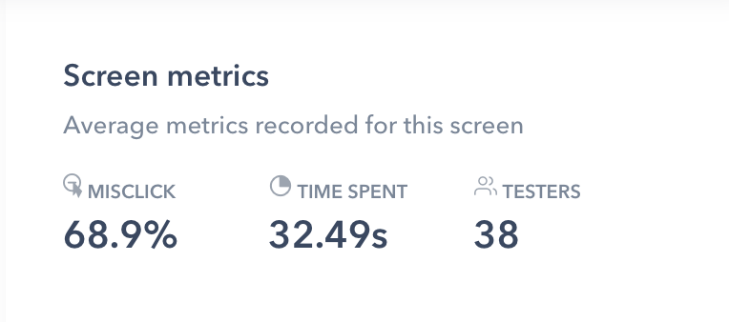

Slide 14
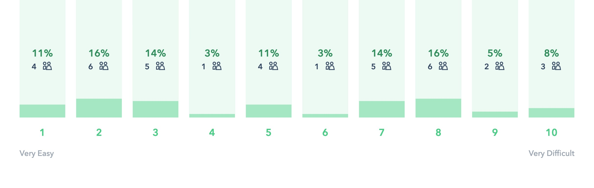
#2: Try to add a note to the report
Rank the difficulty level
Average: 5.2

Slide 15
Second Task -Try to add note: A small onboarding might be needed. Or maybe the “Add Note Window” should be open on first use.

Slide 16
#3
Third Task
Add note on the report
Tests the ability of the user to find the “Add Note” icon
on the top of the report and open the “Add Note Window”
and connect the note to a specific item on the report

Slide 17
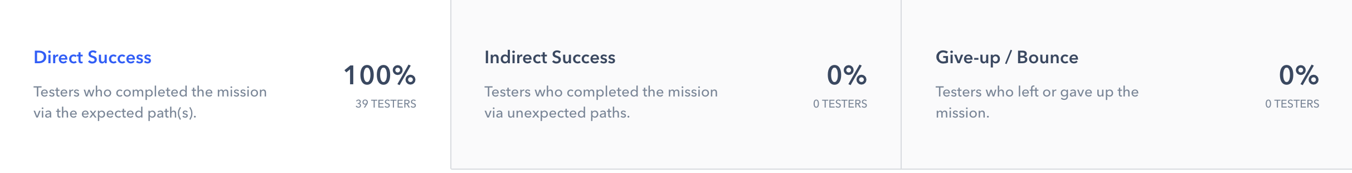
#3: Add a note to the report
Statistics

Slide 18
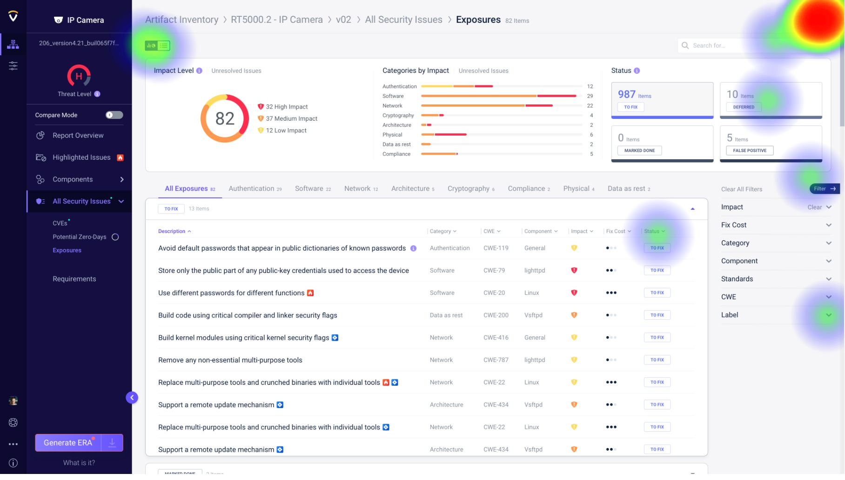
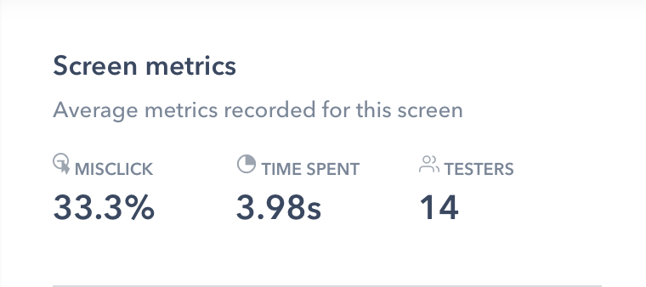

Slide 19
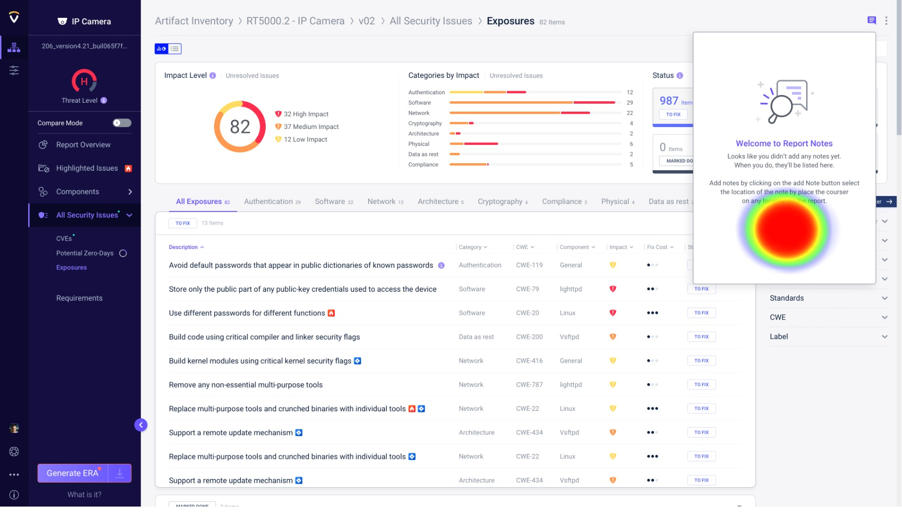
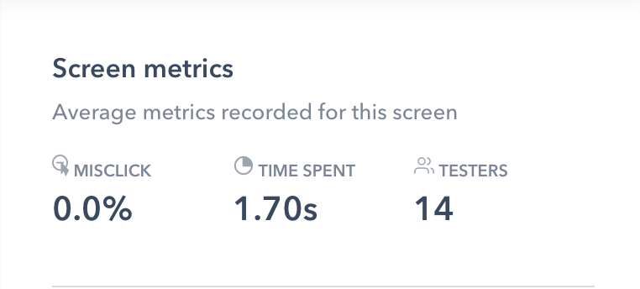

Slide 20
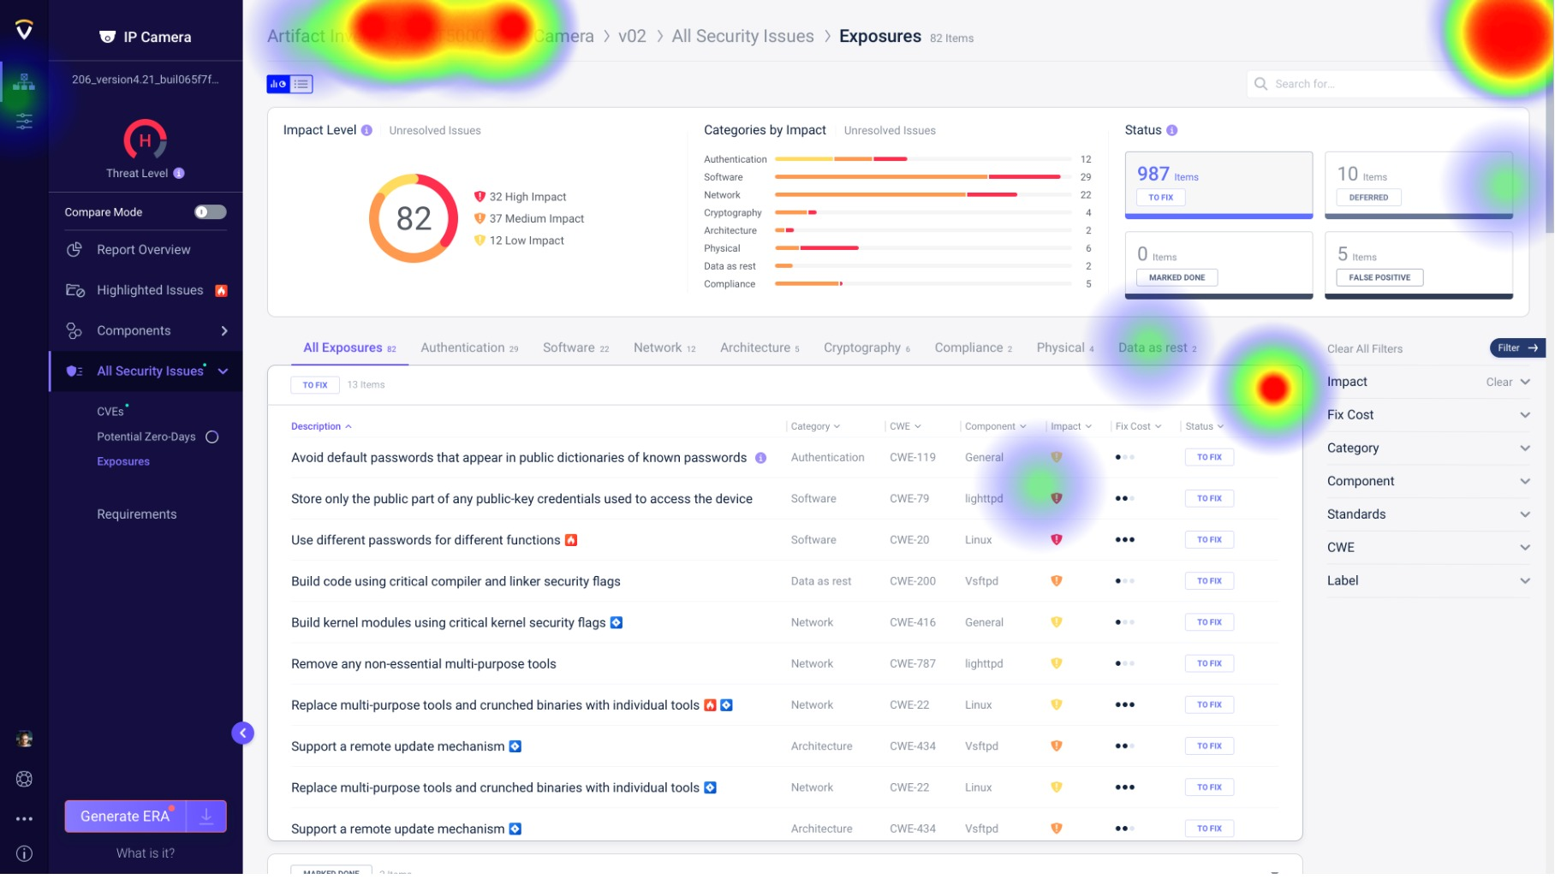
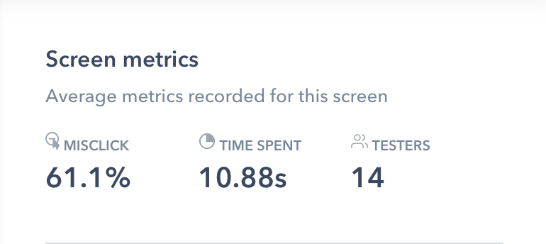

Slide 21
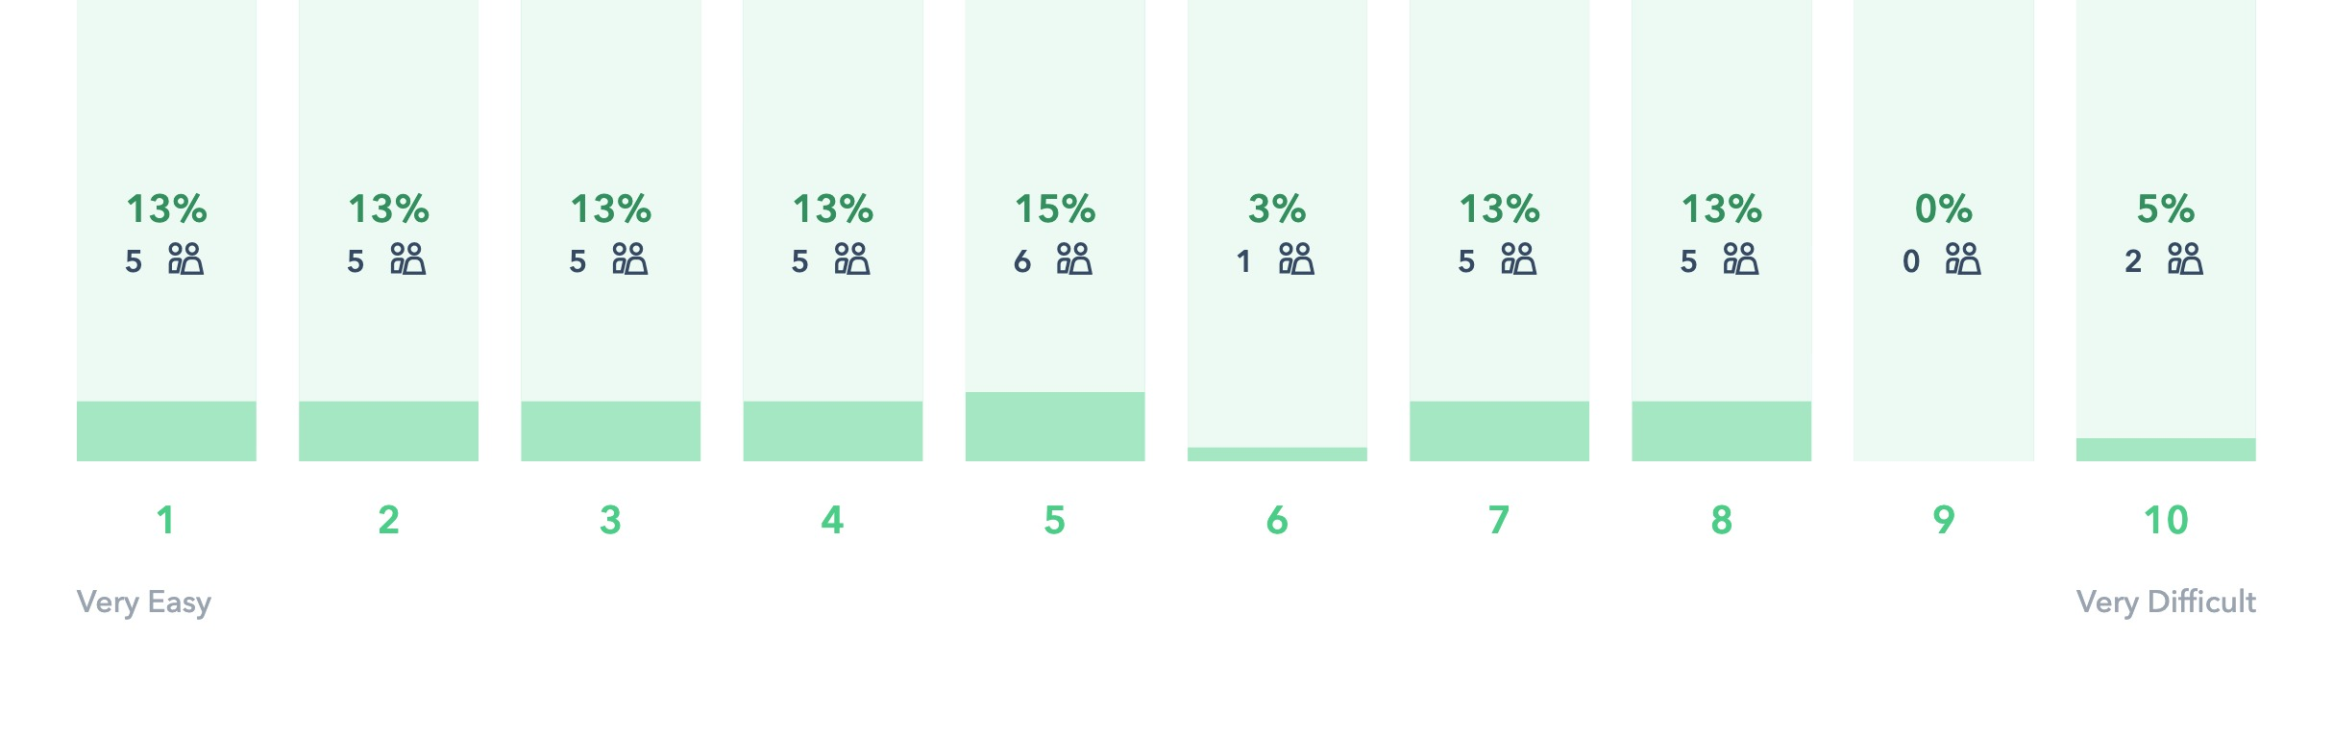
#3: Add note on the report
Rank the difficulty level
Average: 4.6

Slide 22
We asked for suggestions – See quotes
"This is a very odd UI choice IMO. I would not have expected it to work this way. Rather, it seems like a way to add a note to the _entire_ report, not to a part of it. Maybe highlighting all the relevant note locations even without a mouse-over would be good.” Michael S.
”Not used to contextual flow in UI, maybe its better to dim the other (not relevant) items in the UI
and leave only those that can be clicked.” Yuri Paliy
”Too complicated” Ofer
"Nothing to add. This task was very clear.” Dany
Notes:
בגלל שלא ניתן היה לשחזר התנהגות אולי לא הובנה לחלוטין

Slide 23
Third Task - Add note on a specific item: Maybe on clicking on the “Add Note” button – All the items that can be selected will be visible for a second.

Slide 24
#4
Fourth Task
Create a note, then change the state
Tests the ability of the user to find the state
of the note and change it from open to closed

Slide 25
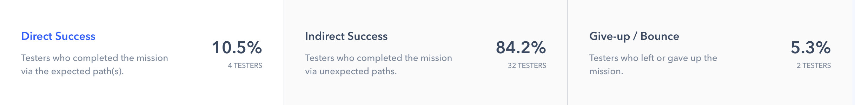
#4: Create a note, then change the state
Statistics

Slide 26
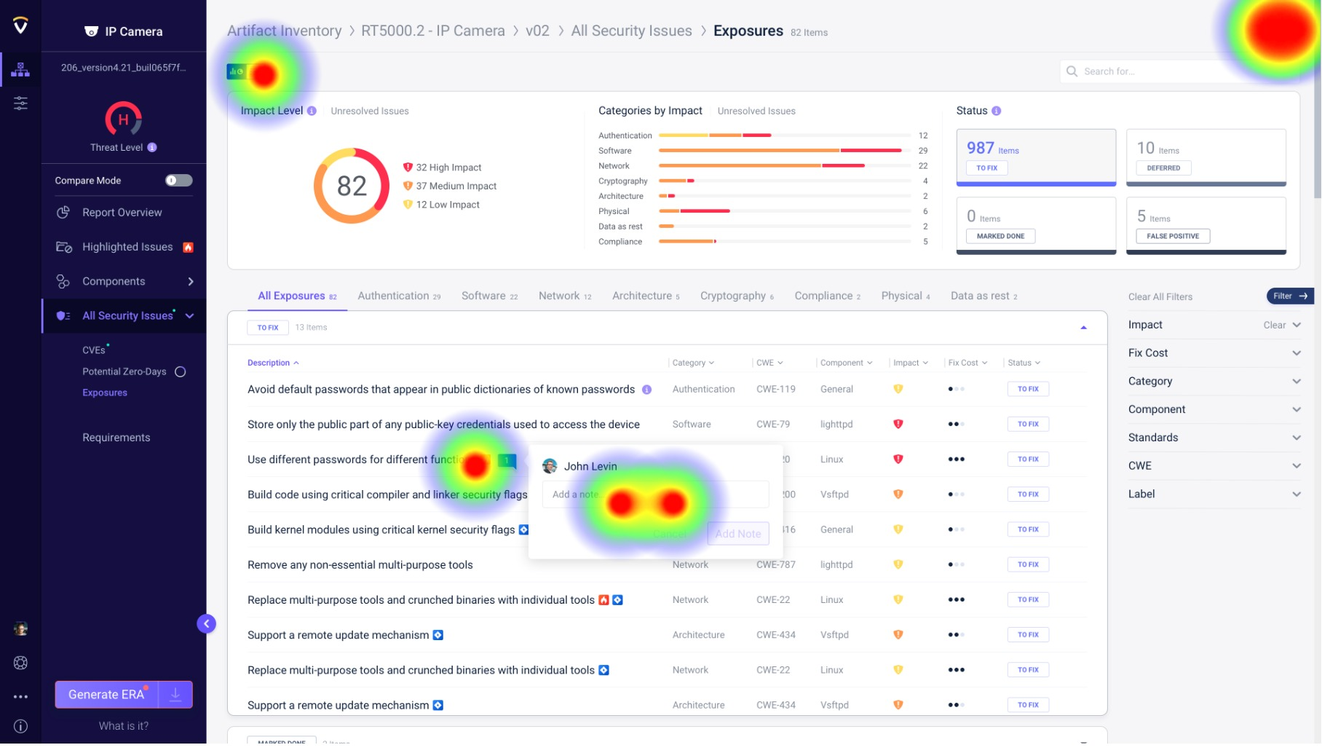
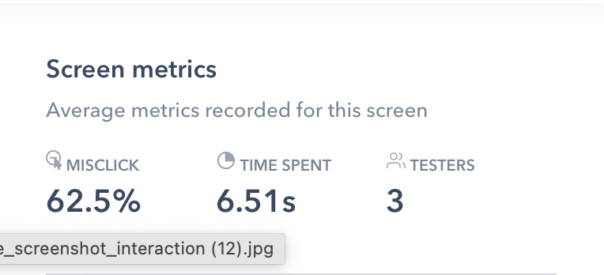

Slide 27
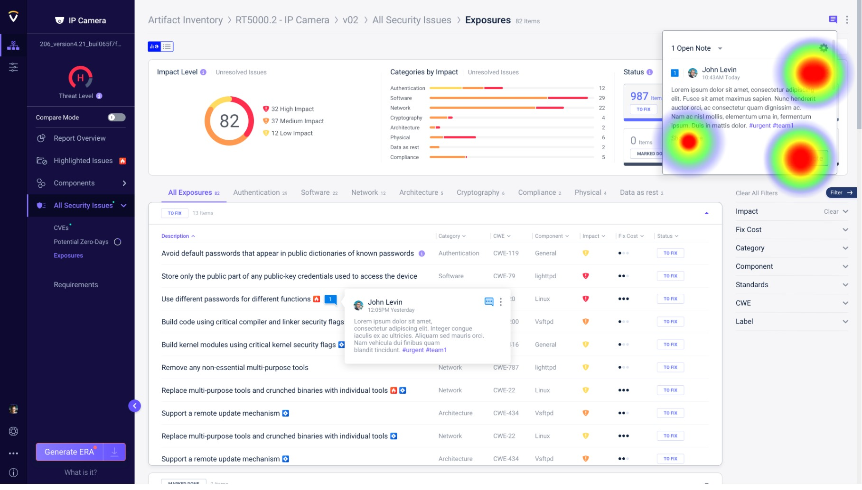
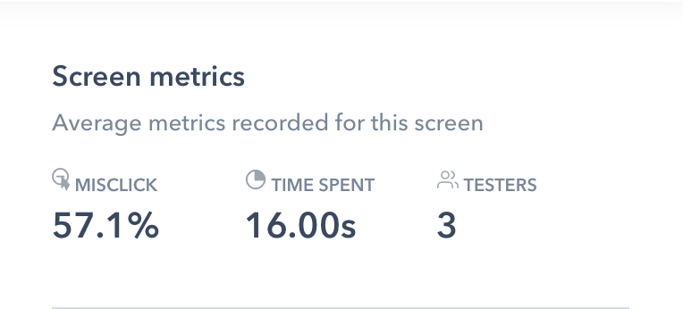

Slide 28
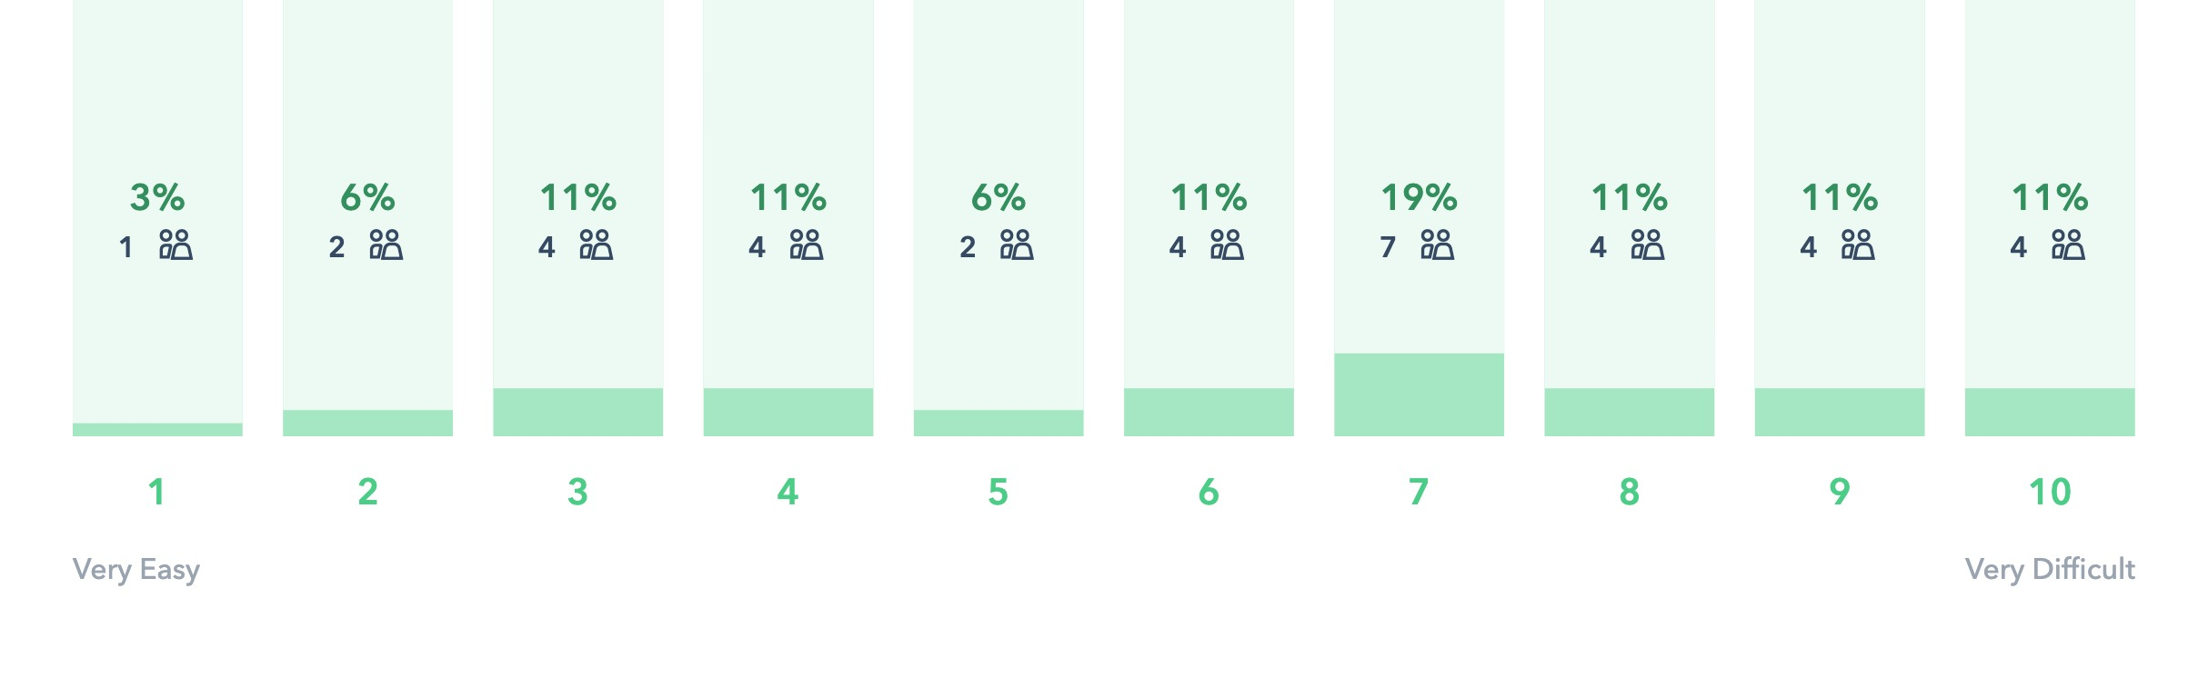
#4: Create a note, then change the state
Rank the difficulty level
Average: 6.2

Slide 29
We asked for suggestions – See quotes
”The button that closes the note does not look like a button that closes notes” Nimrod Zach
"Since I didn't know what indicates "open" at the beginning, I couldn't guess where to click to change the status. why not simply say "open" and "resolved"? ” Nati
"I simply couldn't understand that the button's meaning was "close note” Gal Shahar
"It would be more intuitive through the 3 dots menu” Ori Hollander
"The close icon feels like a comments button.” Asaf Karas
"It's not clear what have I done. Also, the initial note was hard to spot” Igor Z

Slide 30
Fourth Task - Change the state: The state concept was not very clear, the tooltip was not visible enough in the mockup, we might need to add a text next to the state icon or move it to the “Kabab menu” of the note.

Slide 31
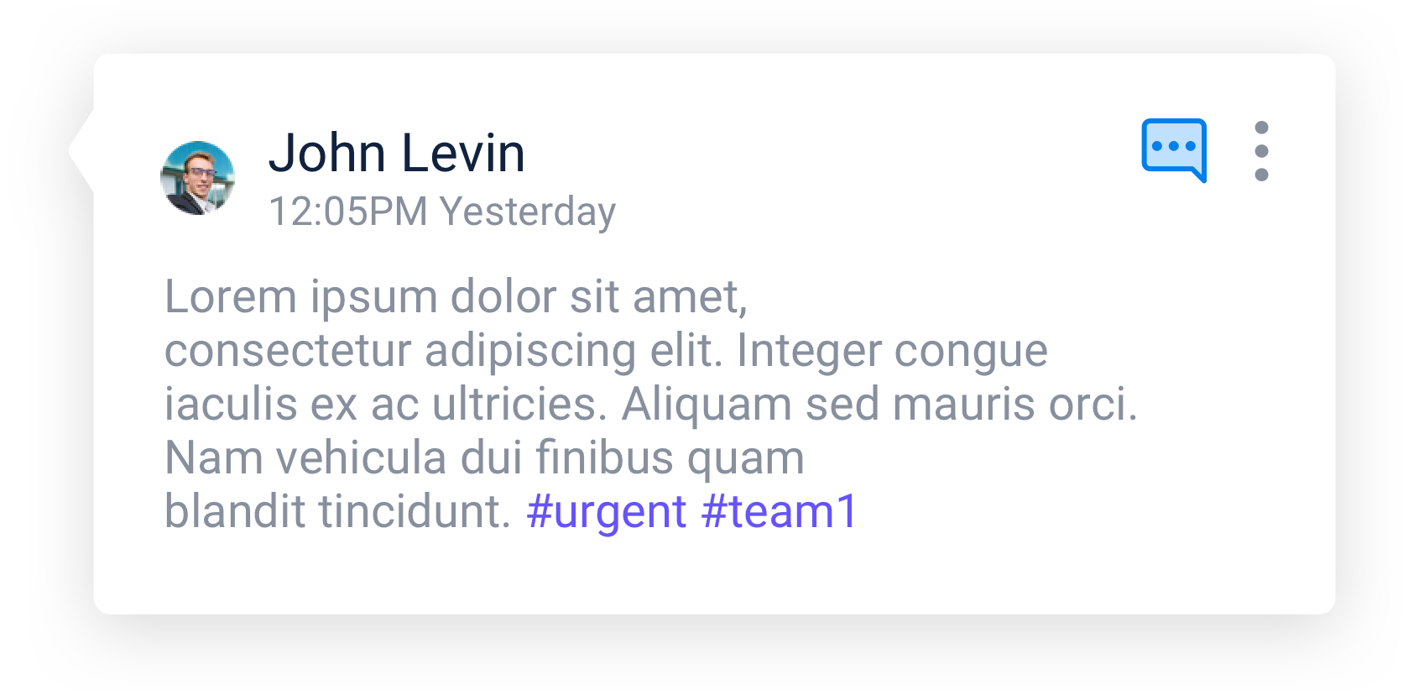
#5
Fifth Task
Hashtag in note
What do you think is the purpose of the hashtags in the notes?

Slide 32
We asked for suggestions – See quotes
”Tag someone or use it afterwards for searching a tag” Jonathan Sar Shalom
"Maybe there is another place in the user's views (not in the specific report) where the team can browse notes by hashtags? Note: I don't see a way for the user to know he can use hashtags - maybe when editing the text there should be a toolbar above the editing box suggesting adding hashtag, bolding the text etc.” Meir Tsvi
”Notify the relevant team (using slack for example)” Yaniv Rogers
"They look like they are for searches. If they are for pre-defined tags/names/statuses - probably better to change them from a hashtag display to a proper tag - with background and boundaries. ” Tamir

Slide 33
#6
Sixth Task
View only resolved notes on the report
Tests the ability of the user to find drop down input field
that will enable them to view resolved notes only

Slide 34
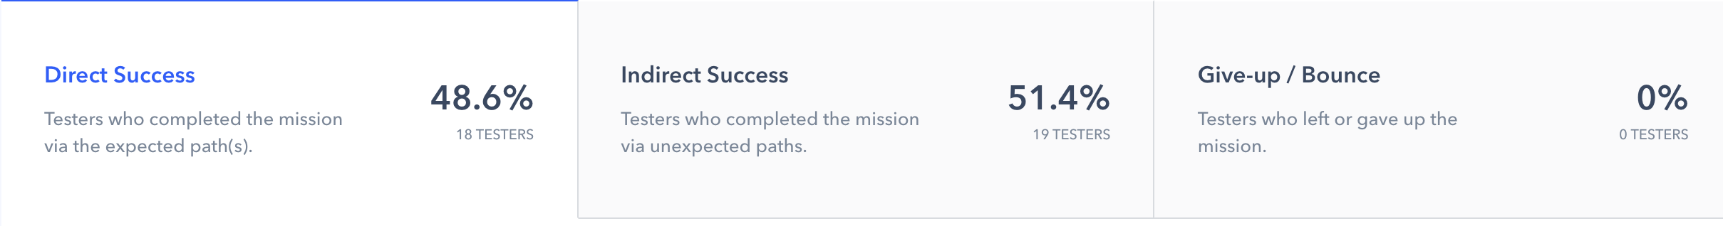
#6: View only resolved notes on the report
Statistics

Slide 35
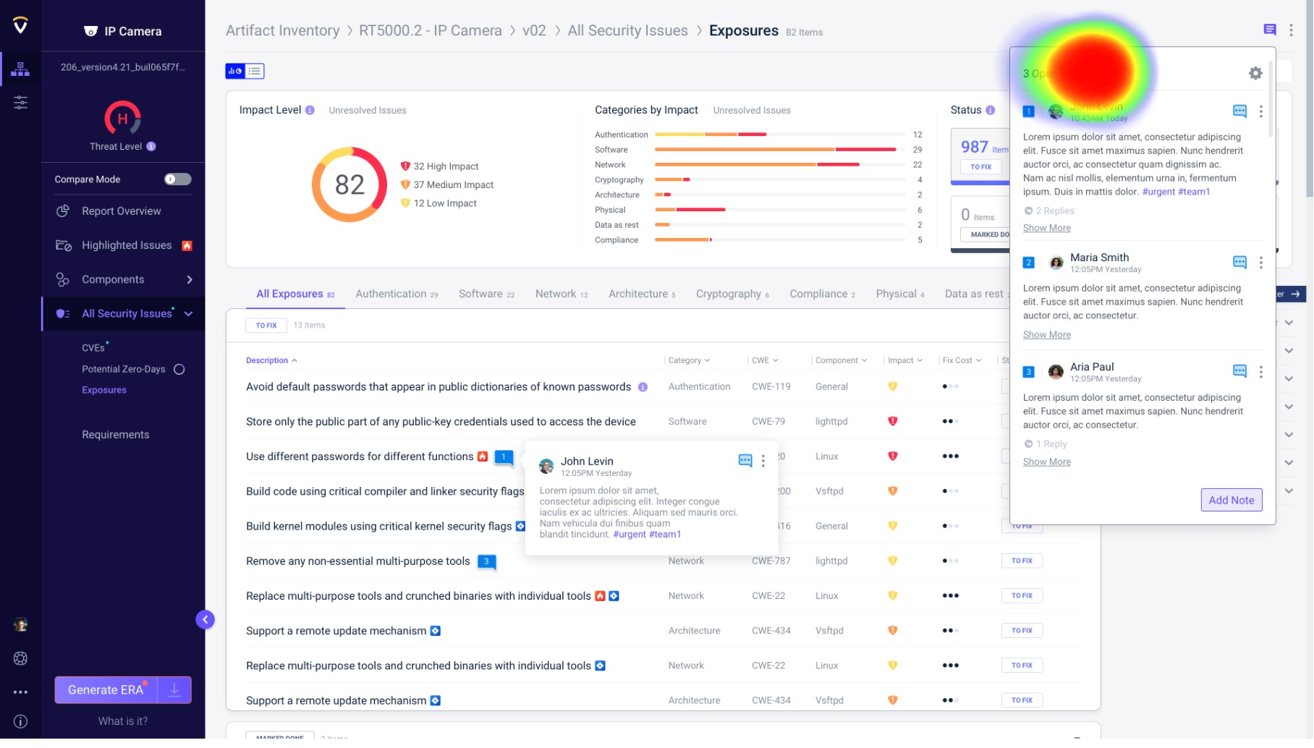
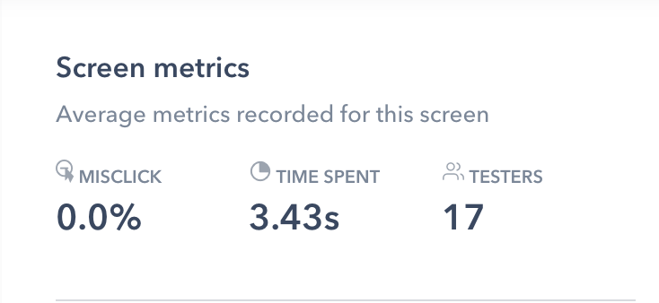

Slide 36
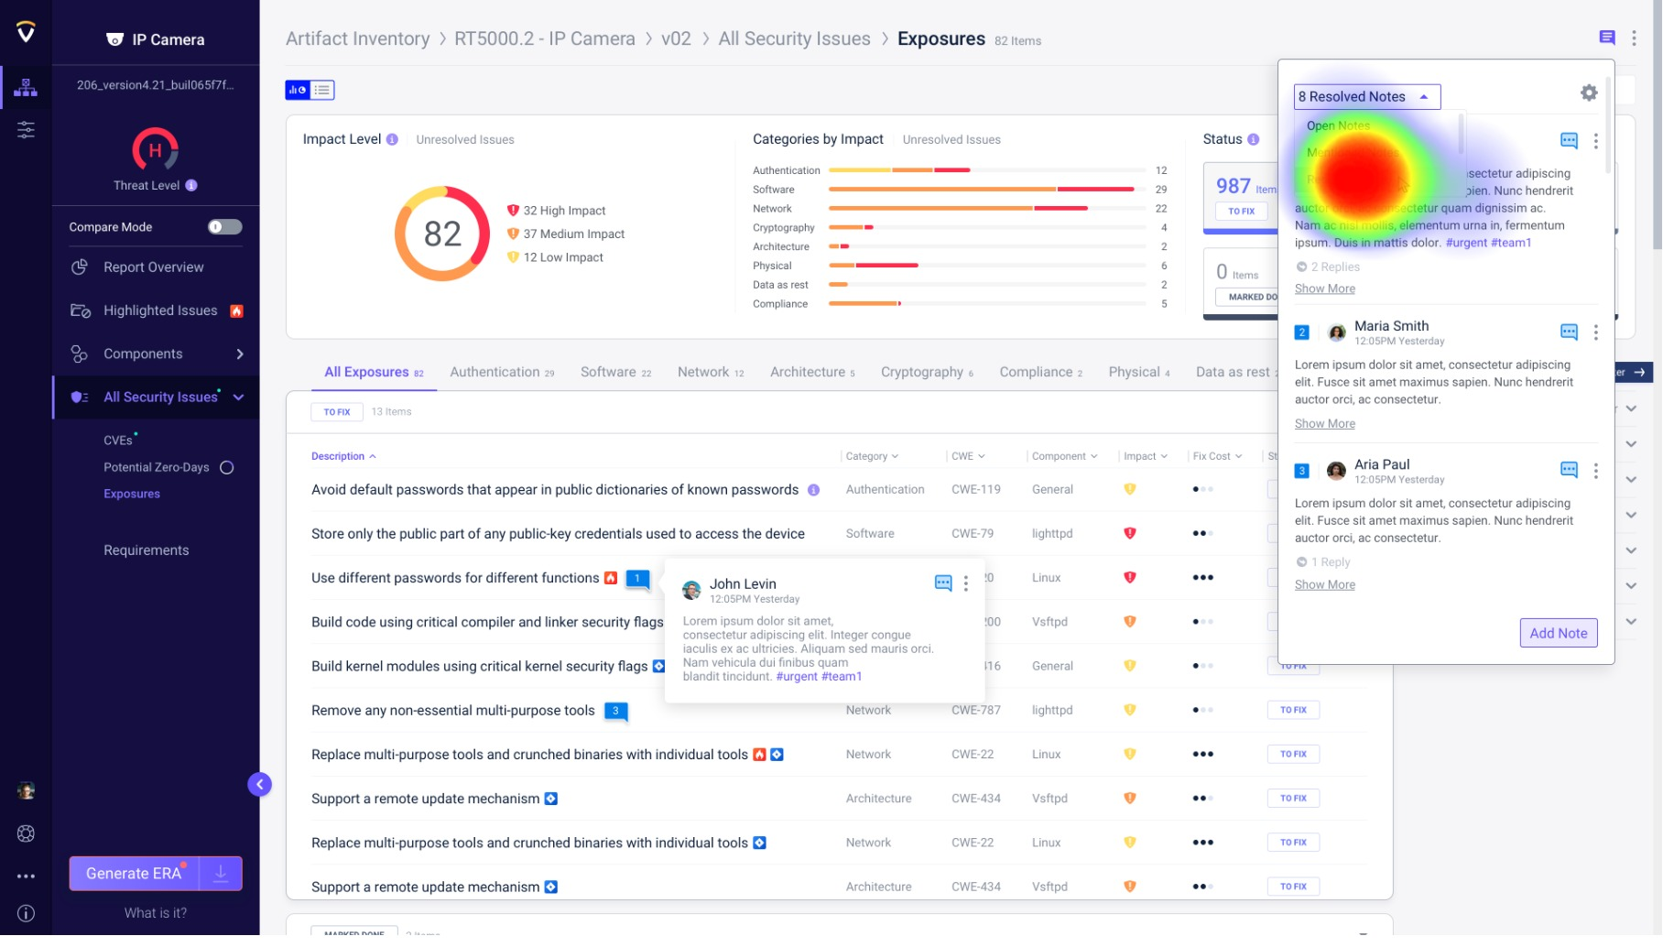
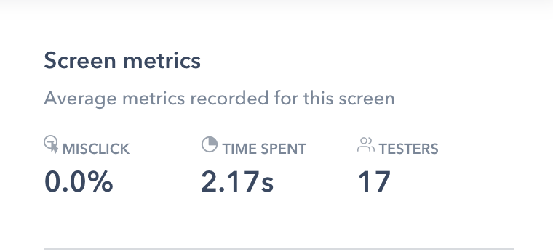

Slide 37
We asked for suggestions – See quotes
”The option to close the report should be inside the note there is a good example
of it in Confluence comments” Ofer
"Was a little bit hard to find” Jonathan Sar Shalom
"Not very intuitive” Leo
"Why isn't a configuration such as what to see in the cogwheel menu?” Eran Brodet

Slide 38
Sixth Task - View resolved notes only: Make the dropdown field more visible - Not only an arrow

Slide 39
#7
Seventh Task
Add note in the exposure (Right pane)
Tests the ability of the user to add note on highlighted text

Slide 40
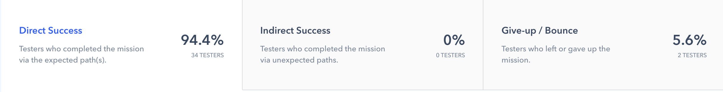
#7: Add note in the exposure (Right pane)
Statistics

Slide 41
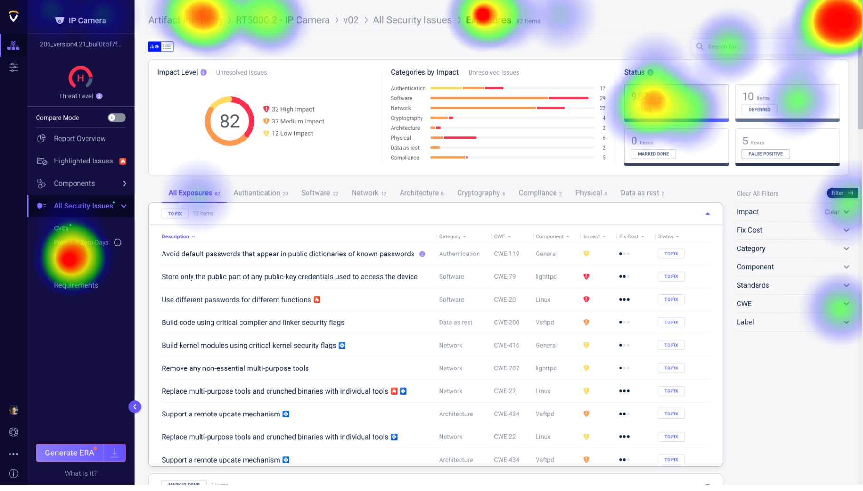
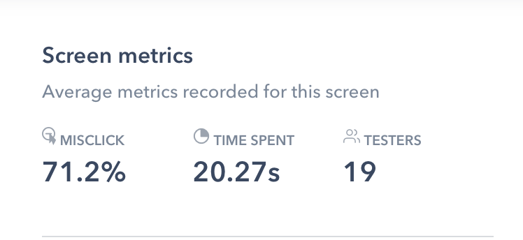

Slide 42
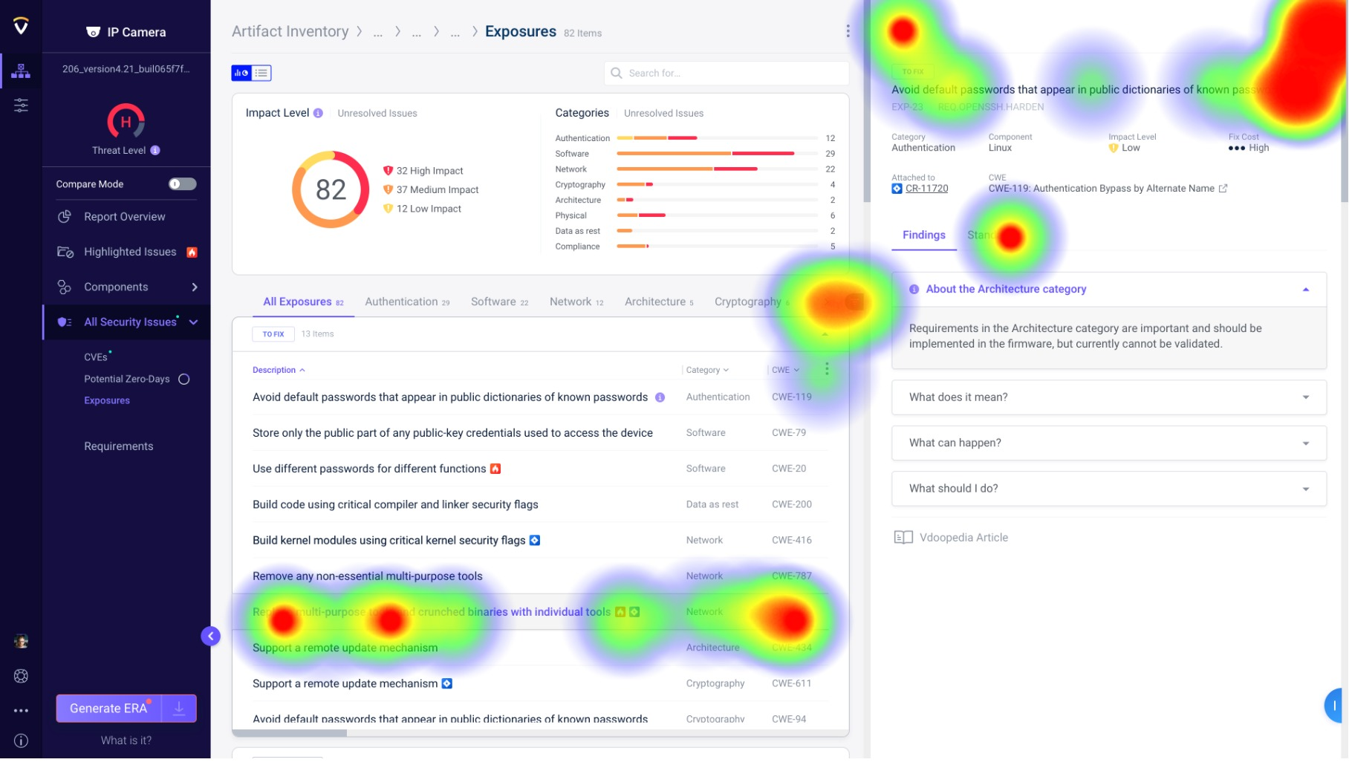
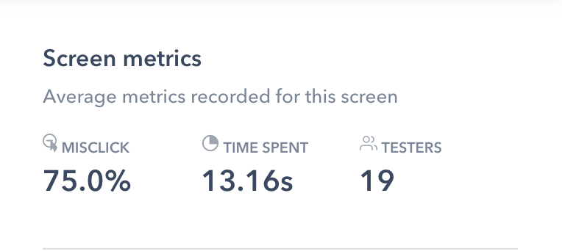

Slide 43
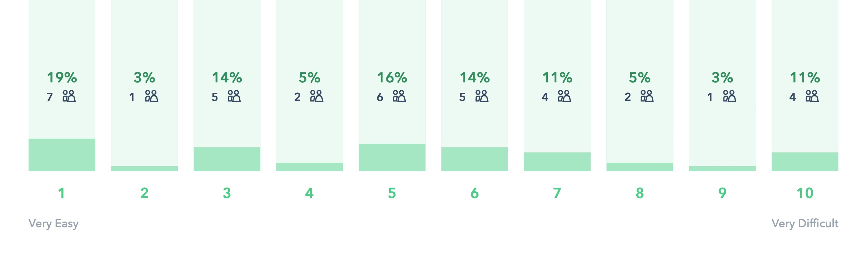
#7: Add note in the exposure (Right pane)
Rank the difficulty level
Average: 5

Slide 44
We asked if the task was intuitive and ask for suggestions – See quotes
”The note icon should be more visible ” Ofer
"Not intuitive. Is you see it only when you hover then you might never know it's there! Same opinion about text on the items - I suggest to have a static "comment" icon on this level as well. ” Nati Davidi
"I think it will be more comfortable to create another button instead of clicking on the text” Afeck Berger
”Action changed from the same option in table ” Alon R
"I searched for an icon but when I hovered the text I understood how to add the note” Yael
"Not intuitive and will make it hard to copy” Asaf Karas

Slide 45
Seventh Task - Add note on text: The highlighted text concept was not very clear; at the1st phase we may discard this behavior, or add an explanation.

Slide 46
#8
Eighth Task
Delete all notes at once
Tests the ability of the find the setting menu and delete all notes

Slide 47
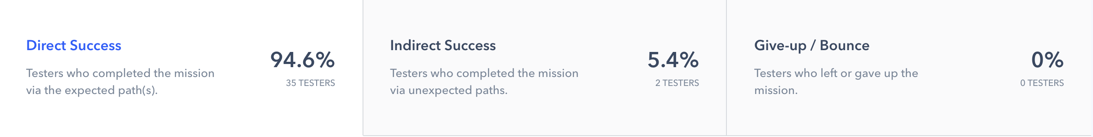
#8: Delete all notes at once
Statistics

Slide 48
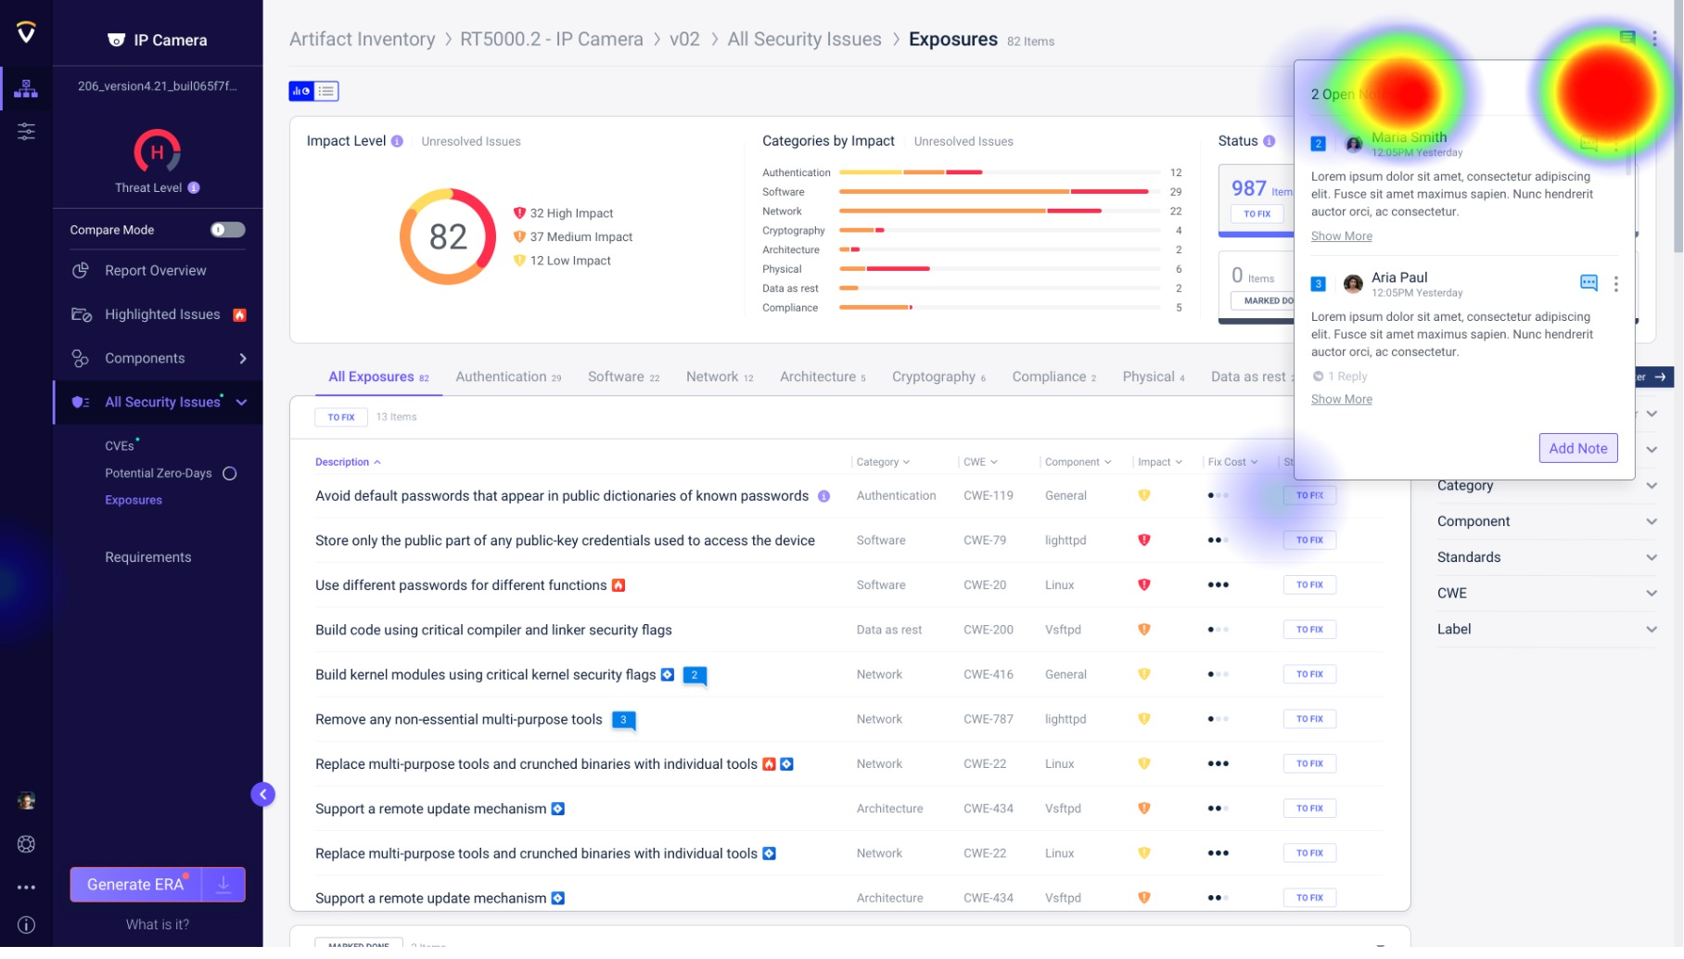
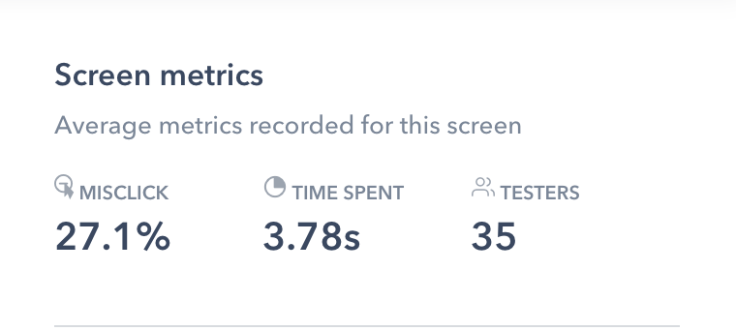

Slide 49
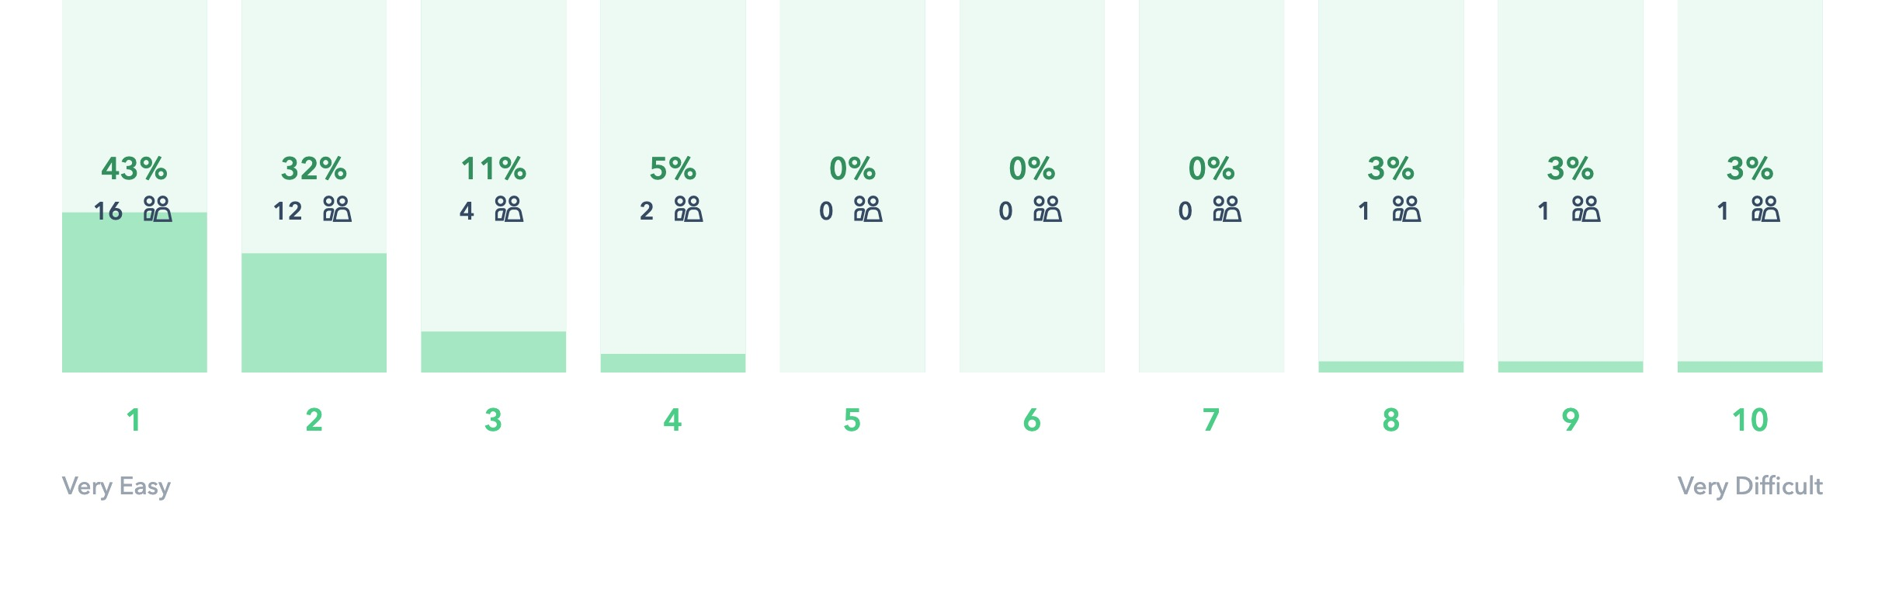
#8: Delete all notes at once
Rank the difficulty level
Average: 2.4

Slide 50
We asked if the task was intuitive and ask for suggestions – See quotes
"In Word and other tools we have Undo, here we don't so it's a very dangerous action (even deleting a single note). We need to offer a way to recover deleted notes.” Meir Tsvi
"That is a very destructive operation and I would not want one, and If I would I'd like an undo. I generally don't think its a good idea to cloud the user with too many notes for a particular issue. If a discussion is to be made about an exposure or a CVE then it should not be in notes attached to the CVE but rather in a Jira issue (or equivalent). Personally I think that if there are more then 3 notes attached to a single item it would be hard to interact with, e.g., read it at the side of the screen.” Yuri Paliy
"Was easier because I explored the "settings" menu earlier, while looking for something more difficult.” Leo

Slide 51
Eighth Task – Delete all notes: The behavior was clear to the users, we may consider the ability to undo deletion, or view deleted notes at least for a while.

Slide 52

All Conclusions

Slide 53
We asked why not – See quotes
First Task - Add Note in table: Maybe at this point not use the kabab menu for adding a note or considering making the “Kabab menu” more visible or using an “Add note” icon instead of “kabab menu”.
Second Task -Try to add note: A small onboarding might be needed. Or maybe the “Add Note Window” should be open on first use.
Third Task - Add note on a specific item: Maybe on clicking on the “Add Note” button – All the items that can be selected will be visible for a second.
Fourth Task - Change the state: The state concept was not very clear, the tooltip was not visible enough in the mockup, we might need to add a text next to the state icon or move it to the “Kabab menu” of the note.

Slide 54
We asked why not – See quotes
Sixth Task - View resolved notes only: Make the dropdown field more visible - Not only an arrow
Seventh Task - Add note on text: The highlighted text concept was not very clear; at the1st phase we may discard this behavior or add an explanation.
Eighth Task – Delete all notes: The behavior was clear to the users, we may consider the ability to undo deletion, or view deleted notes at least for a while.

Slide 55
Thank you

